Slide 1
SUMMARY REPORT
Forwarding and warehousing

Slide 2
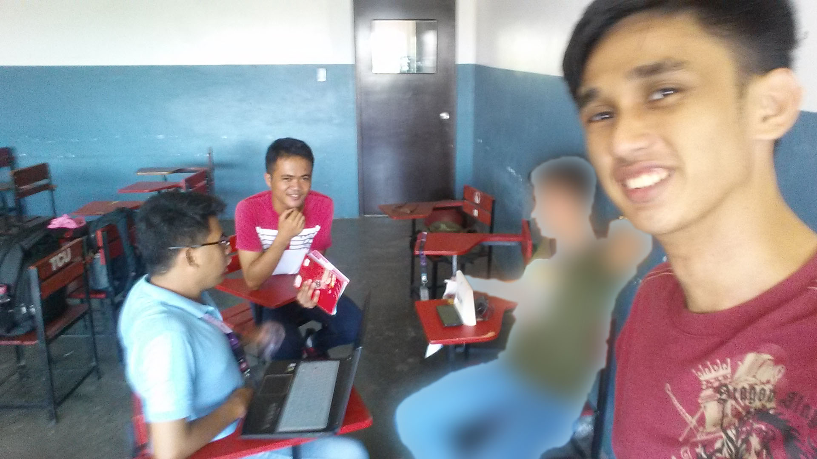
Our research is from the employee of a known big forwarding company.

Slide 3
Forwarding
Send Different items by their category.

Slide 4
Two types of placing goods / item
1. Reefer Van
For the foods need to be store in cold places
2. Container
For ordinary and fragile item

Slide 5
Forwarding vs Warehousing
Forwarding
Transporting of goods
Warehousing
Store of products
When the system is in use it is not accessible outside.

Slide 6
3 categories of Delivery
1. AIR FREIGHT
Super rush delivery
2. LAND FREIGHT
Different types of land freight
- 6 wheelers
- Van
- Motorcycle (document)
3. SEA FREIGHT
It save more because shipping of goods is multiple

Slide 7
CUBIC METER - VOLUME OF ITEM OR MEASUREMENT OF ITEM IN SHIPPING

Slide 8
Forwarding data process
1. BOOKING
Numbers of delivery / item with tracking number
cubic meter
Numbers of truck for delivery
Pickup address
Delivery address
Contact / receiving person
Paying for the book (if the item is deliver)

Slide 9
2. Proof of Delivery
document for receiving
3. Demurrage = Storage Fee (Optional)
If the item in the warehouse is to long makes the delay of the delivery

Slide 10
FORWARDING USERS
1. ADMIN
can check the inventory, maintenance / all access
2. SUPER USER
can manipulate data (quantity only)
3.USER
can view data and a receiver

Slide 11
CRUD
(Module connection)

Slide 12
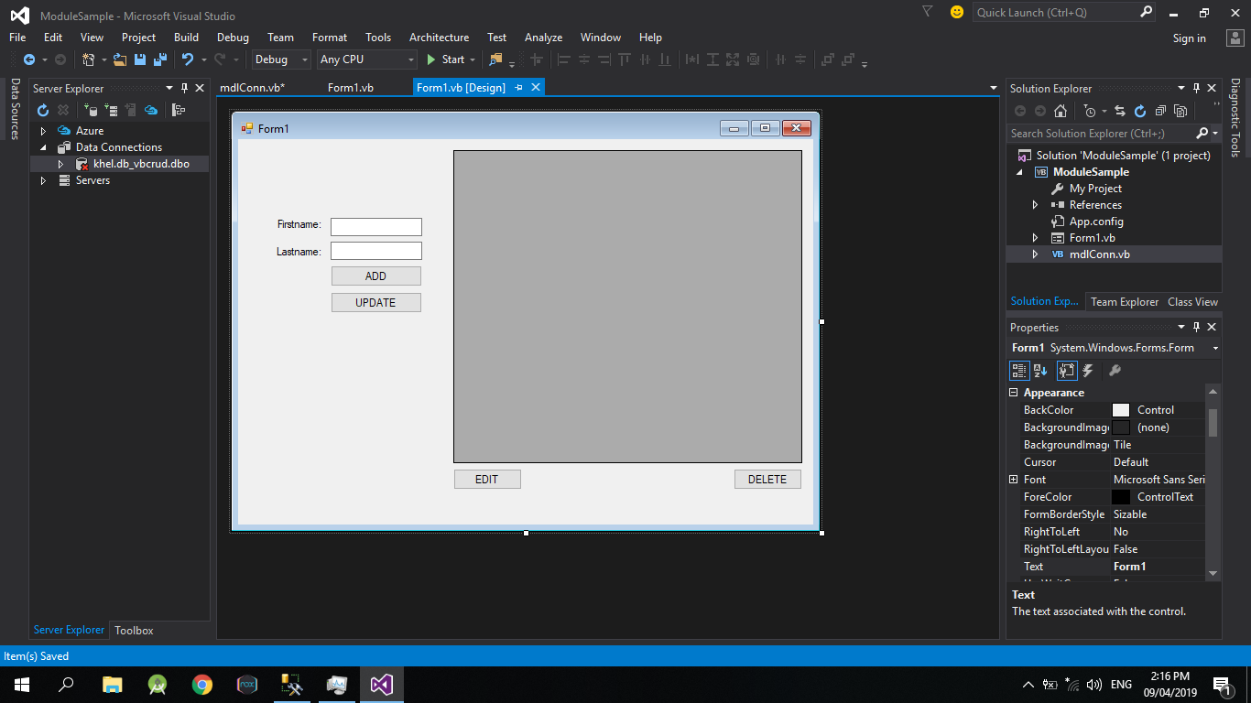
SAMPLE CRUD GUI

Slide 13
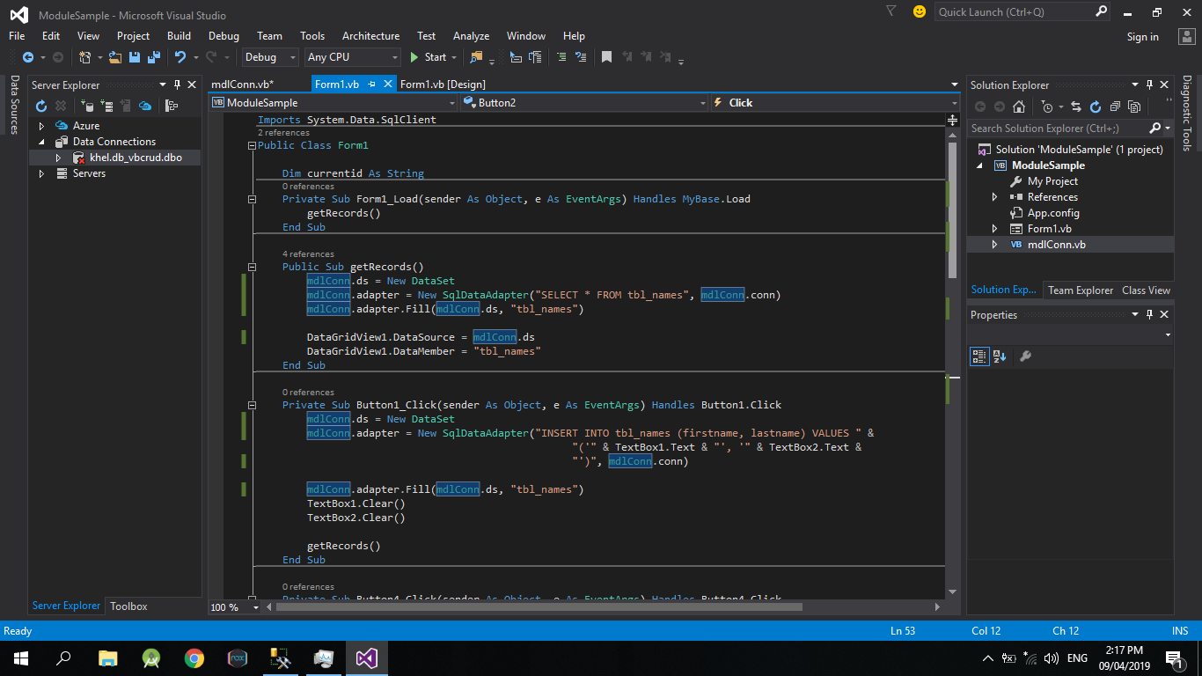
CODE – insert, select, update, delete

Slide 14
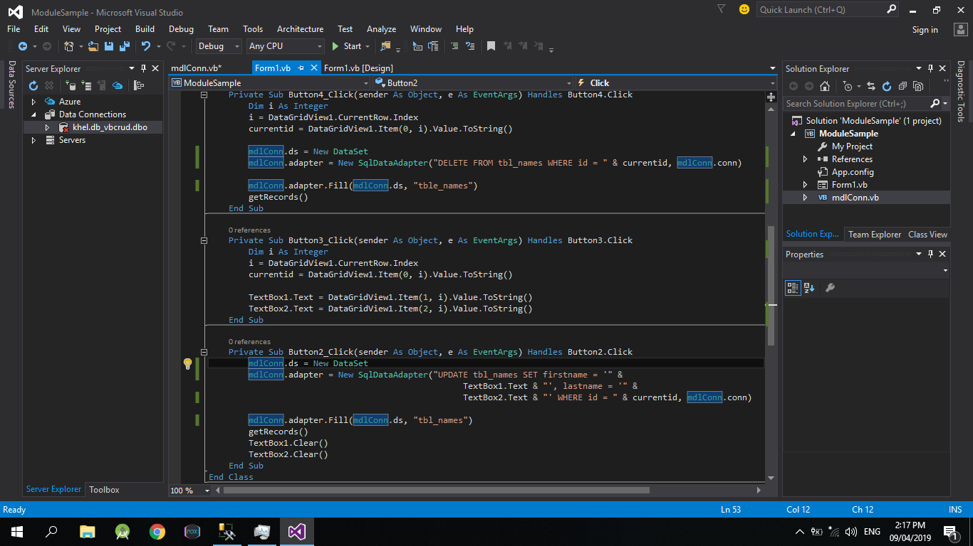
CODE – insert, select, update, delete

Slide 15
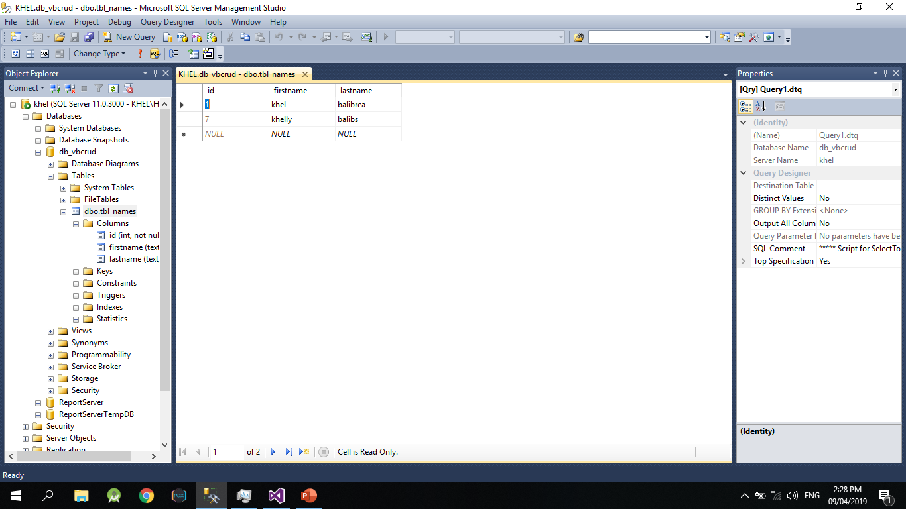
SQL

Slide 16
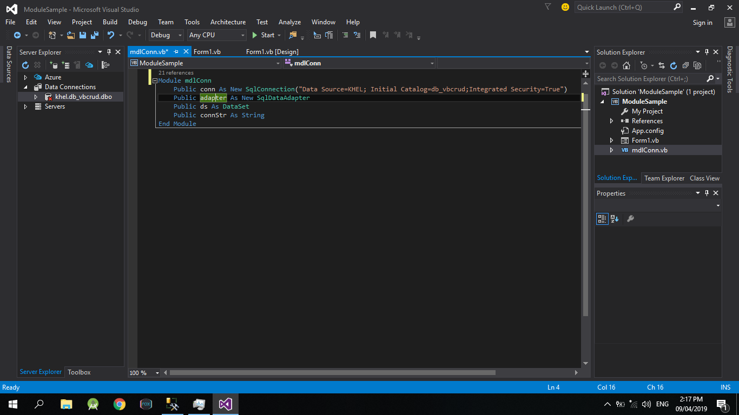
CODE - connection

Slide 17
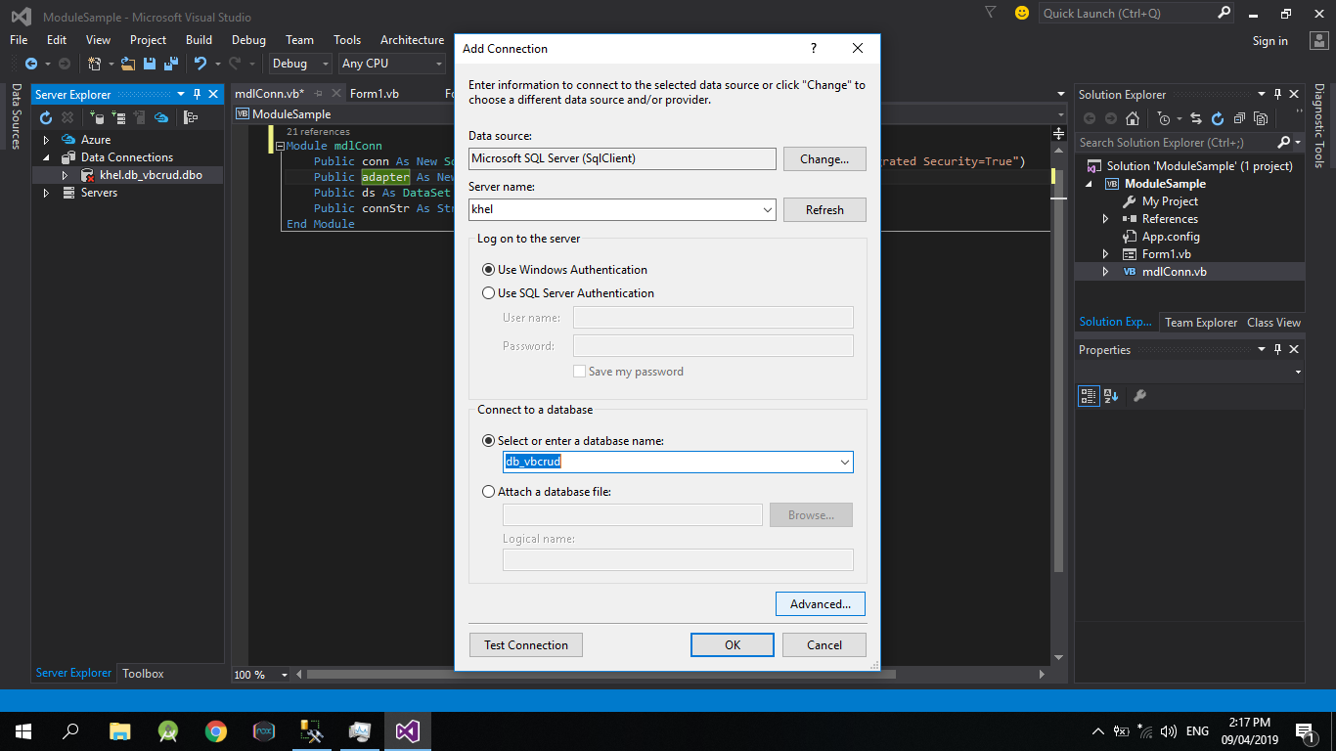
Connection

Slide 18
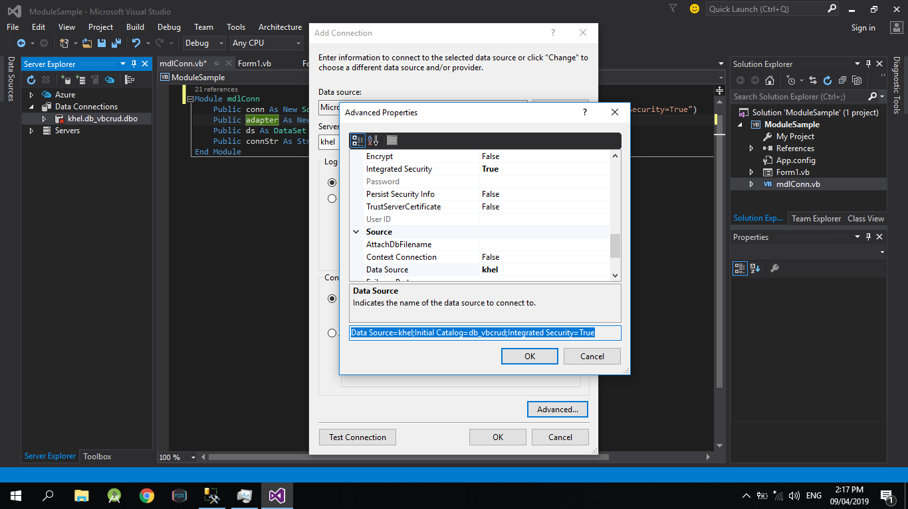
Connection

Slide 19
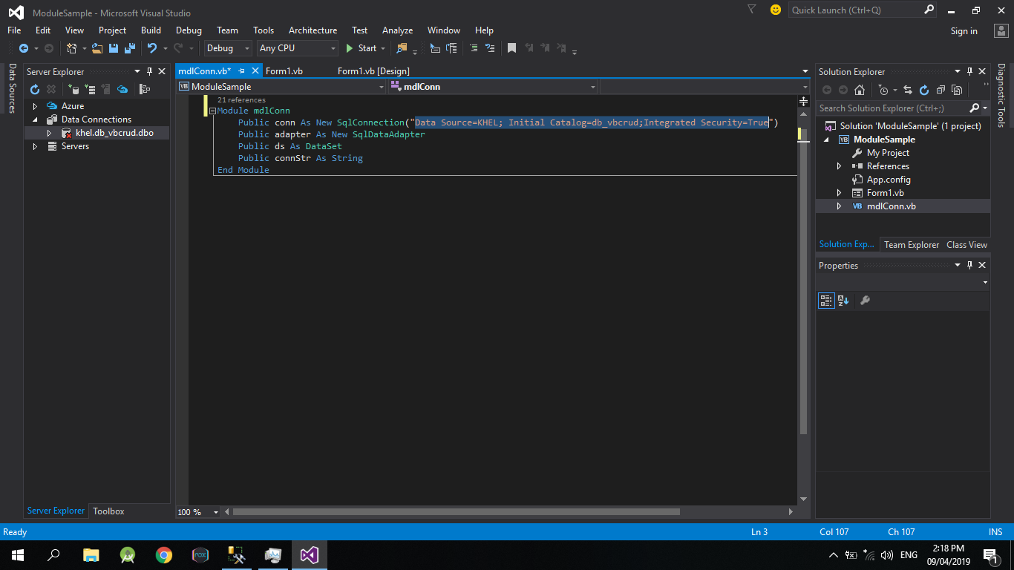
Connection

Slide 20
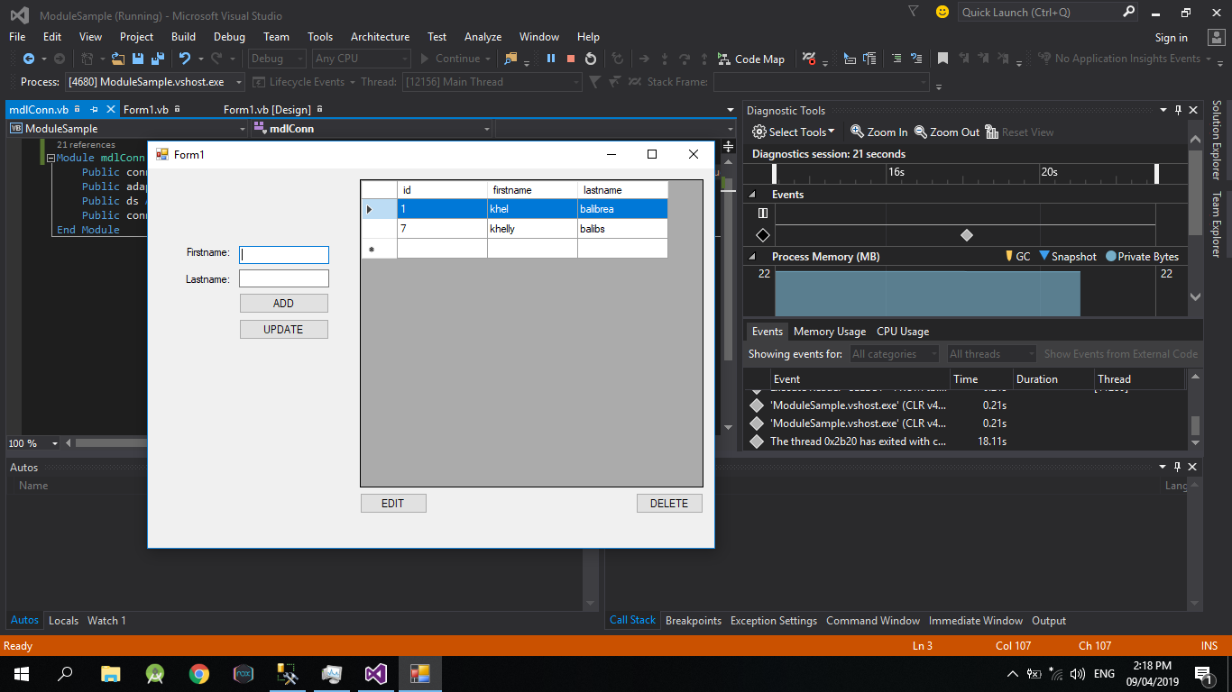
Test Run

